Slide 1

INCIDENT & INCIDENT RESPONSE METHODOLOGY

Slide 2
Define : Incident
Incidents are events that Interrupt normal operating procedure & precipitate to some level of crisis

Slide 3
Computer Security Incident
(w.r.t Computer Forensics)
A computer security incident as any unlawful, unauthorized, or unacceptable action that involves a computer system or a computer network

Slide 4
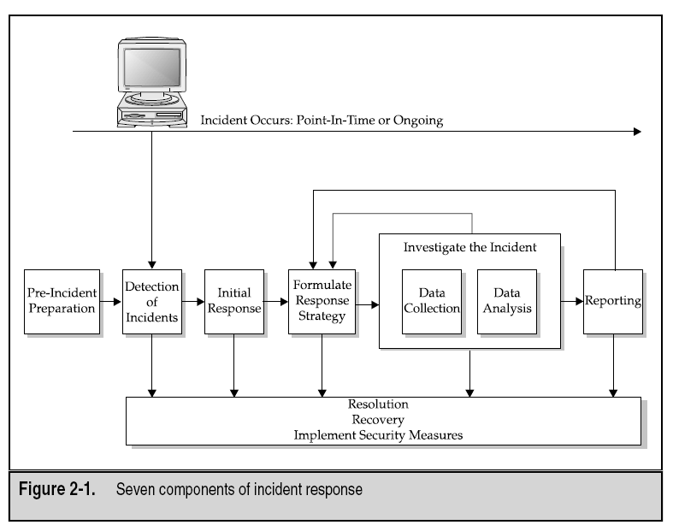

Slide 5
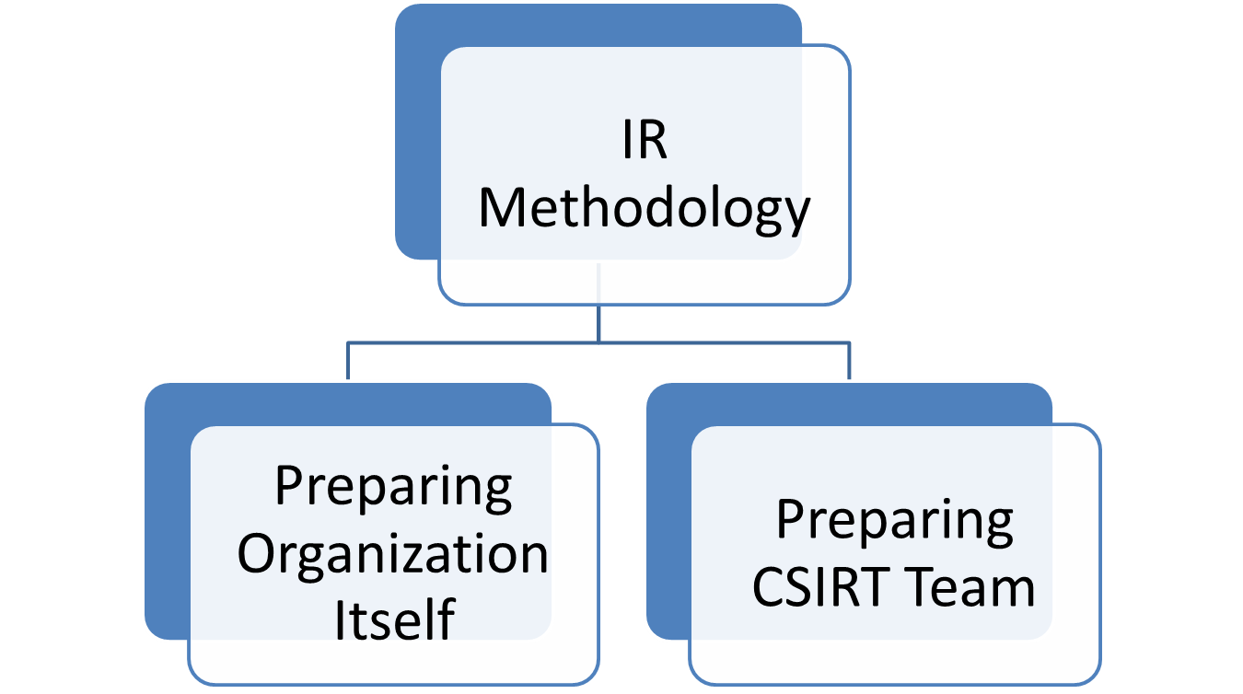
1. Pre-Incident Preparation - PIP

Slide 6
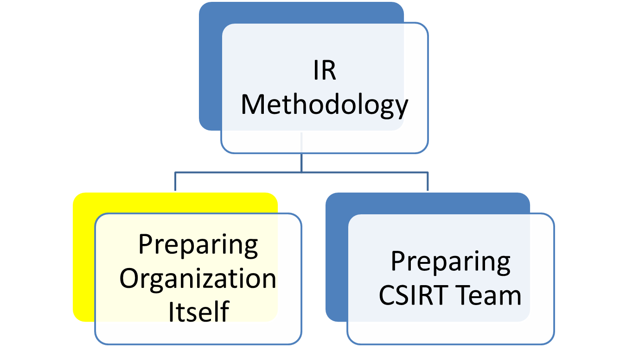
1. Pre-Incident Preparation - PIP

Slide 7
1. PIP
1a. Preparing Organization Itself
Implementing host-based security measures
Implementing network-based security measures
Training end users
Employing an intrusion detection system (IDS)
Creating strong access control (ACL)
Performing timely vulnerability assessments
Ensuring backups are performed on a regular basis

Slide 8
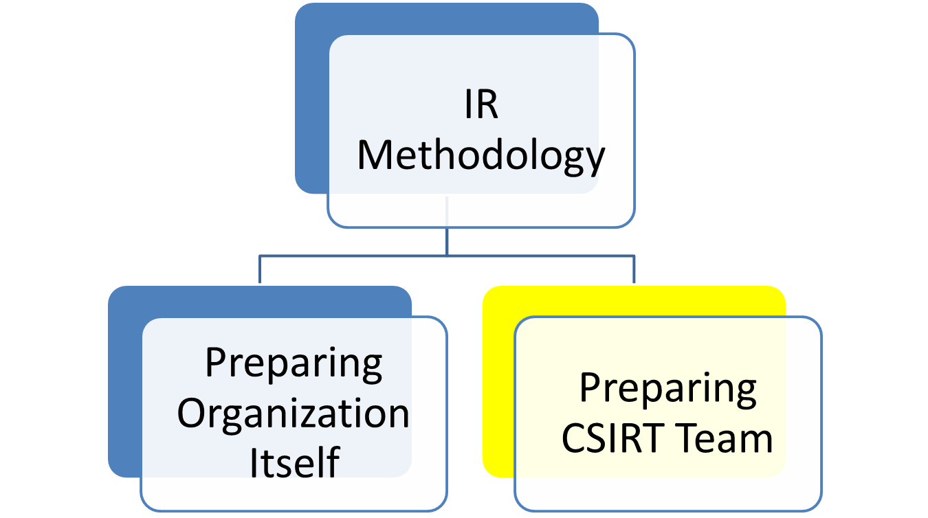
1. Pre-Incident Preparation - PIP

Slide 9
1. PIP
1b. Preparing CSIRT Team
The hardware & software needed to investigate computer security incidents
The documentation (forms and reports) needed to investigate computer security incidents
The appropriate policies and operating procedures to implement your response strategies
The training your staff or employees to perform incident response in a manner that promotes successful forensics, investigations, and remediation

Slide 11
2. Detection of Incidents
No Detection = No Success
Detection By → End User, Admin, IDS, Anybody
Detection Reported by 3 ways
Immediate Supervisor
Corporate HELPDESK
Hotline to IR Team
(Once reported) – We need Maximum details about an Incident
2a. Simple Check-List
2b. Complex Check-List

Slide 12
2. Detection of Incidents
2a. Simple Check-List
Current time and date
Who/what reported the incident
Nature of the incident
When the incident occurred
Hardware/software involved
Points of contact for involved personnel

Slide 13
2. Detection of Incidents
2b. Incident Response Check-List
An Incident Response Check-List consists of 5 Modules.
2.b.1) CONTACT INFORMATION
2.b.2) INCIDENT DETECTION
2.b.3) SYSTEM DETAILS
2.b.4) INCIDENT CONTAINMENT
2.b.5) PRELIMINARY INVESTIGATION
** Will be discussed in U1 – M3

Slide 15
3. Initial Response
Initial Response involves & answers the following Phases :
Assemble CSIRT
Ensure the Incident
Collect ample Data(via IR Check-List)
Assessing the Impact

Slide 16
3. Initial Response
We don’t touch the system in this phase but the DATA Collected are Reviewed through the Phases :
Interview Sys-Admin – Tech Insight of Incident
Interview Business managers - Business Insight in context of Incident
Review IDS Report & Network Logs
Review ACL & Network topology

Slide 18
4. Formulate a Response Strategy
The Objective is to Determine best Strategy by considering Political, Technical, Legal & Business Factors
4a. Considering the Totality of the Circumstances
4b. Considering Appropriate Responses
4c. Taking Action

Slide 19
4. Formulate a Response Strategy
4a. Considering the Totality of the Circumstances
How critical are the affected systems?
How sensitive is the compromised or stolen information?
Who are the potential perpetrators?
Is the incident known to the public?
What is the level of unauthorized access attained by the attacker?
What is the apparent skill of the attacker?
How much system and user downtime is involved?
What is the overall dollar loss?

Slide 20
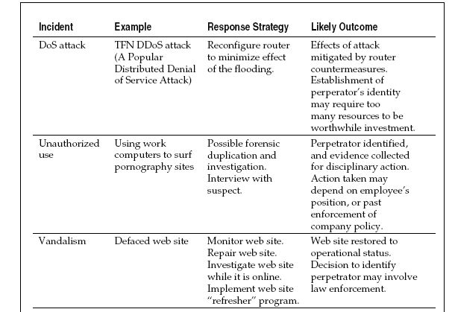
4. Formulate a Response Strategy
4b. Considering Appropriate Responses

Slide 21
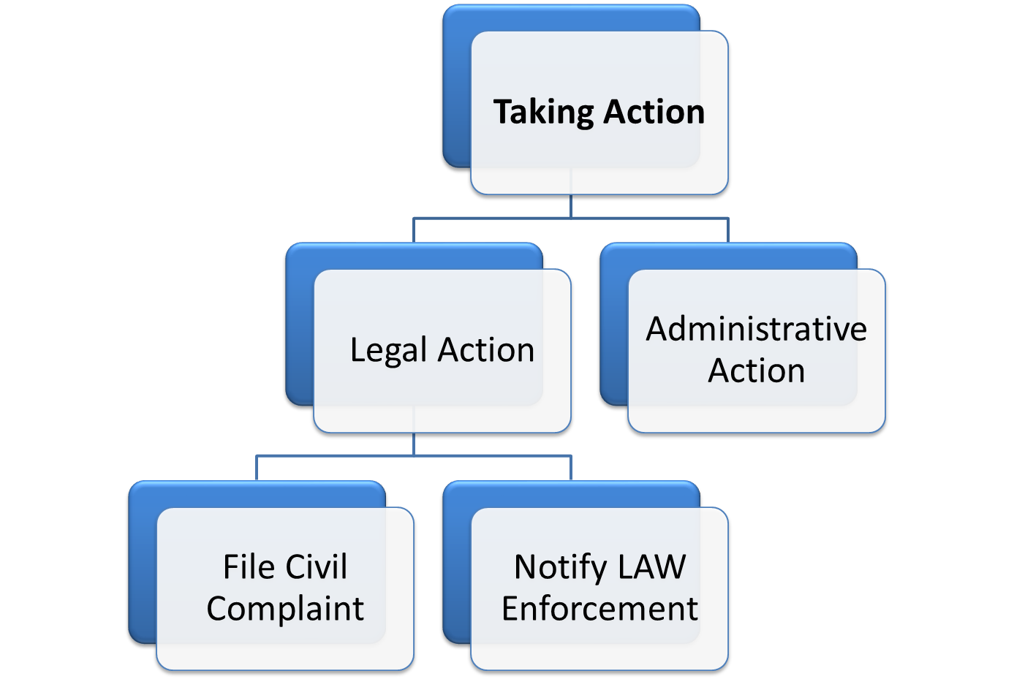
4. Formulate a Response Strategy
4c. Taking Action

Slide 22
4. Formulate a Response Strategy
4c. Taking Action
Check while including Law Enforcement
Does the damage/cost of the incident merit a criminal referral?
Does criminal action will achieve the outcome desired by your organization?
Does organization have proper documentation and report for investigation.
Does organization have working relation with Law enforcement.
Impact in Business due to Law enforcement involvement

Slide 23
4. Formulate a Response Strategy
4c. Taking Action
Administrative Action Includes :
Immediate dismissal
Letter of reprimand
Mandatory leave of absence for a specific length of time
Reassignment of job duties (diminished responsibility)
Temporary reduction in pay to account for losses/damage
Public/private apology for actions conducted
Withdrawal of certain privileges, such as network or web access

Slide 25
5,6. Investigate the Incident
The investigation phase involves determining the who, what, when, where, how, and why surrounding an incident.

Slide 26
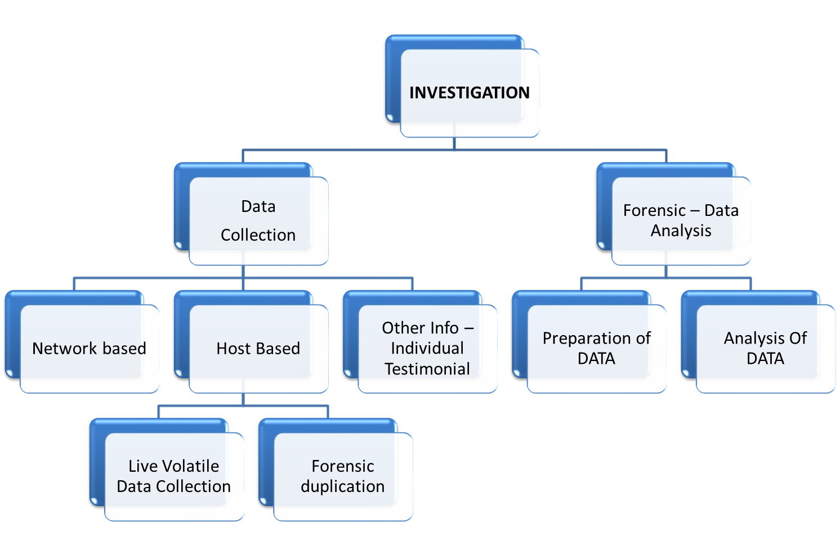
5,6. Investigate the Incident

Slide 27
5,6. Investigate the Incident
A computer security investigation can be divided into two phases: data collection and forensic analysis.
Data Collection Phase, you gather all the relevant information needed to resolve the incident in a manner that meets your response strategy.
Forensic Analysis Phase, you examine all the data collected to determine the who, what, when, where, and how information relevant to the incident

Slide 28
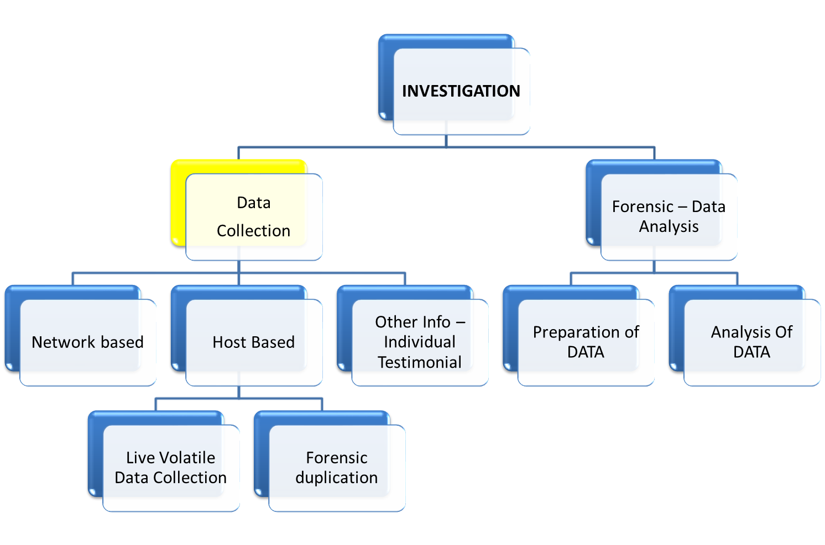
5,6. Investigate the Incident

Slide 29
5,6. Investigate the Incident
5) Data Collection
Data collection involves several UNIQUE FORENSIC CHALLENGES:
You must collect electronic data in a forensically sound manner.
You are often collecting more data than you can read in your lifetime
You must handle the data you collect in a manner that protects its integrity (evidence handling).

Slide 30
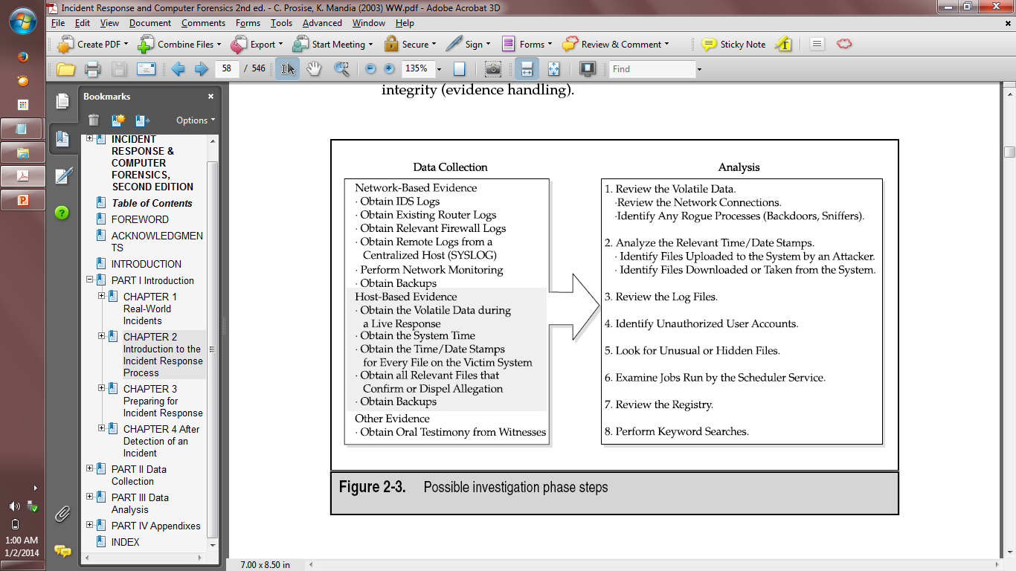
5,6. Investigate the Incident
5) Data Collection
5,a) Host Based Evidence
&
5,b) Network based Evidence
&
5,c) Other Evidence

Slide 31
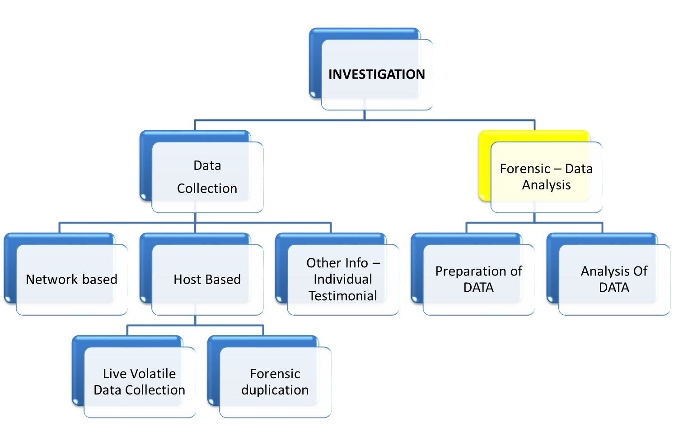
5,6. Investigate the Incident

Slide 32
5,6. Investigate the Incident
6) Forensic Analysis
Forensic analysis includes reviewing all the data collected.
This includes reviewing “log files, system configuration files, trust relationships, web browser history files, email messages and their attachments, installed applications, and graphic files”

Slide 33
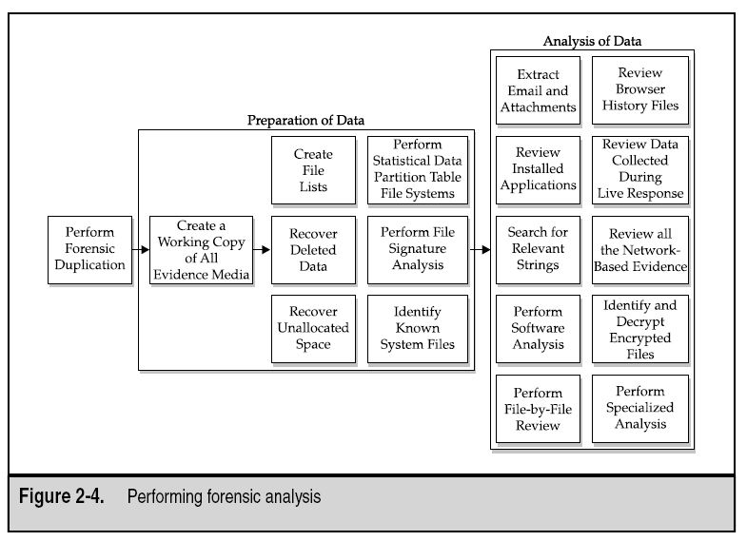

Slide 35
7. Reporting
The challenge is to create repots that
accurately describe the details of an incident, that are understandable to decision makers, that can withstand the legal scrutiny,
and that are produced in a timely manner.

Slide 36
7. Reporting
Document immediately - saves time, promotes accuracy, and Communicated at any moment
Write concisely and clearly - Discourage shorthand or shortcuts. Vague notations, incomplete scribbling, and other unclear documentation
Use a standard format - Develop a format for your reports and stick to it. Create forms, outlines, and templates.

Slide 38
GOALS : Incident Response
  Confirms or dispels whether an incident occurred.
  Promotes the accumulation of accurate information.
  Establishes controls for proper retrieval and handling of evidence.
  Minimizes disruption to business and network operations.
  Allows for legal or civil recriminations against perpetrators.
  Provides accurate reports and useful recommendation.
  Provides rapid detection and containment
  Minimizes exposure and compromise of proprietary data
  Protects your organization’s reputation and assets

